Slide 1




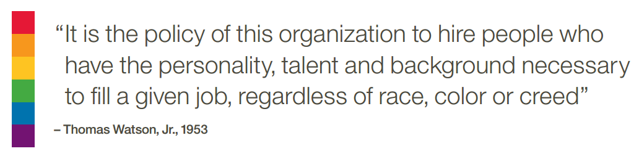
Careers at IBM
David Goddard
Executive IT Specialist, IBM Analytics

Slide 2


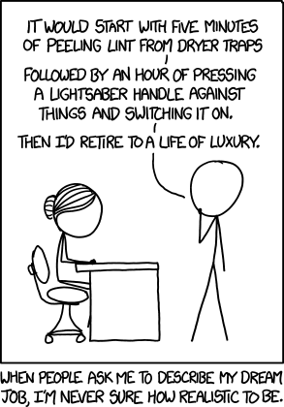
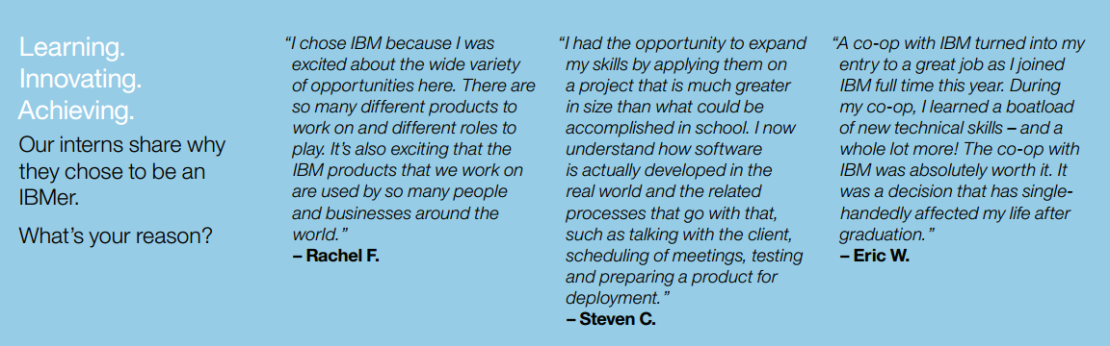
A Culture of Innovation
Continuing 23 years of U.S. patent leadership, with more than 88,000 patents made. That’s 7,355 patents in 2015 alone!
Driving thought leadership with 6 Nobel Laureates, 13 U.S. National Medals of Technology, and 5 National Medals of Science.
Crowdsourcing discovery and funding of IBMer innovations and passion projects.
Advancing early childhood education via an IBM Watson and Sesame Workshop (a.k.a. Sesame Street) collaboration.
Enhancing cloud capabilities and strengthening analytics through partnerships with companies such as Twitter, Facebook, and Box.
A Great Place to Work
Be yourself! We hire from a wide variety of backgrounds.
Make an impact: Work with clients to solve their most pressing problems, from life-threatening diseases to weather and more.
Collaborate globally: ﬂexible work options and agile workspaces, combined with a unique set of collaboration tools.
Continue to grow: access world-class learning and leadership development courses, supported by a goal of 40 hours of learning for each IBMer annually.
Give back: Through the Corporate Services Corps, IBM has engaged 3,000 IBMers to volunteer their service for 1,000 projects in 40 countries to solve issues in development, healthcare, citizen diplomacy and sustainability

Slide 3

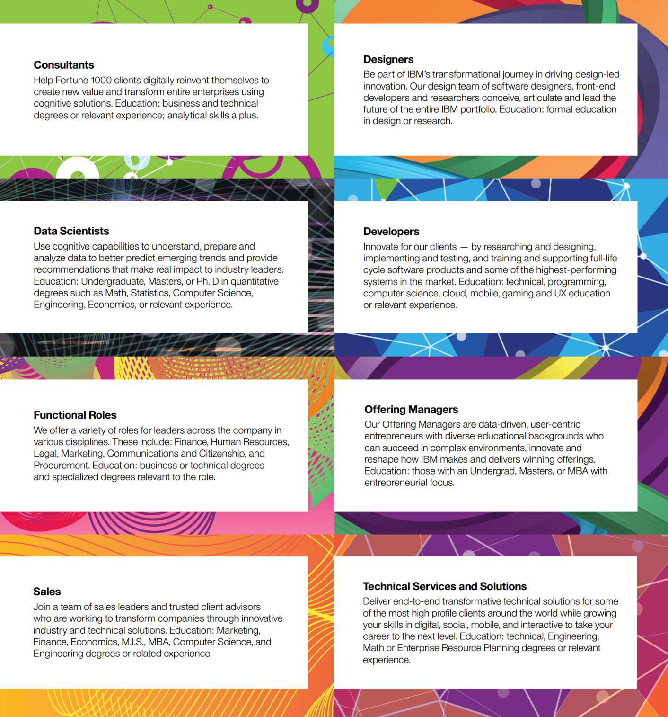
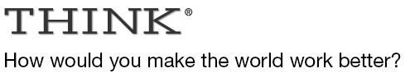




IBM roles

Slide 4

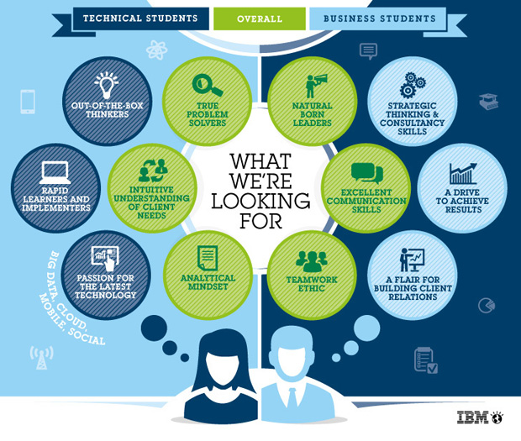
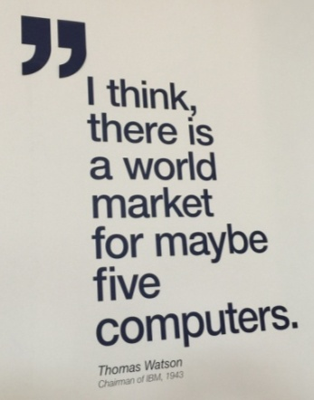


Your strengths
IT degree not essential
Wide range of disciplines can lead to a career at IBM
Develop your potential
Consider how to develop your skills (as well as your résumé/CV)
Build stuff for fun outside of formal education
Consider internships and placements
Internships
Extreme Blue
Apprenticeships
Ability to think & work independently and to develop new skills is your best asset
(you don’t need to be perfect)

Slide 5
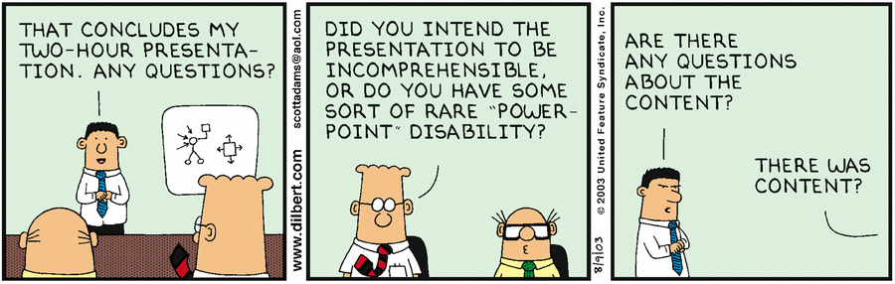

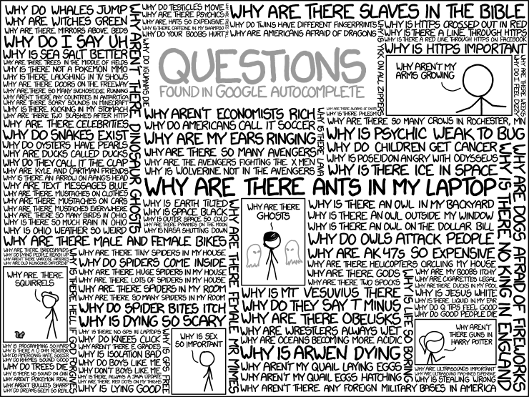
Questions?
https://xkcd.com/1256/

Slide 6





Thank you!
@IBMJobsGlobal
IBMJobsGlobal
https://www.ibm.com/employment/
https://www.ibm.com/employment/us/extremeblue/
https://www.ibm.com/employment/internationalstudents/
https://www.ibm.com/employment/at-de/entrylevel.html

